Slide 1

Your Patent and Paralegal Services Partner Training Plan and Course content
Phone (India): +91-901-367-3286
Phone (US): +1-972-256-8133
Phone (UK): +44-203-286-8233
Web: www.effectualservices.com
Email: info@effectualservices.com

Slide 2
Training – Prior Art Searching
Presentation Plan
Introduction : Trademark Search
What are we looking for?
Key to Searching – Keywords and Key strings
Free – Search Databases
Best Practices

Slide 3
Introduction: Trademark Search
A TRADEMARK is a type of intellectual property consisting of a recognizable sign, design, or expression which identifies products or services of a particular source from those of others, although trademarks used to identify services are usually called service marks.
A TRADEMARK is typically a name, word, phrase, logo, symbol, design, image, or a combination of these elements.
Note:- Trademark is valid for only 10 Years, but it can be renewed.

Slide 4
Introduction: Trademark Search
A TRADEMARKS are also territorial rights, hence a trademark registered in a country is not valid worldwide.
For getting rights in any other country you need to file an application separately for that with their respective trademark office.
However, international conventions such as the Madrid Protocol serve as a centralized registration system for trademark grants in all member countries.
Note:- Madrid Protocol has over 100 members, and it covers the territories of 124 countries.

Slide 5
Training – Specialized courses
Why Trademark registration is necessary?
A registered TRADEMARK establishes ownership over the brand, name or logo. It protects your brand from any unauthorized use of the third party. The registered TRADEMARK proves that the product totally belongs to you and you have exclusive rights to use, sell, and modify the brand or goods in whichever manner you want.
Valuable Assets
Protection to your Brand
Provides Uniqueness to Brand
Easy Communication tool
Easy for customers to find

Slide 6
Why Trademark search is essential for your business?
The search aims to find the same or similar trademarks that one plans to use. The applicant must involve in the search to check whether the same/similar trademarks are used in goods or services related to the ones they are planning to cater for.
The trademarks can be very similar without being the same. Names can look similar, or sound alike. Do not forget to check for alternative word endings and spellings when you are doing a trademark search. Of course, uncovering all exact matches is a requirement. Besides, if the goods and services are not related, they are likely to have the same registered trademarks.

Slide 7
Types of Trademark searches
WORD MARK SEARCH – Search by word, class, and description of good or service,
DESIGN MARK SEARCH – Search by Vienna code and class,
PHONETIC SEARCH – Search by word mark and class and therefore word marks that sound similar.

Slide 8
Benefits of conducting a TradeMark search
Prevention from spending money and resources on a mark that might not be available.
2) Providing with time and flexibility to amend the mark before launching the goods and services.
3) One can avoid the costs of business distraction associated with the forced rebranding.
4) One can avoid dispute litigation costs.
5) Also, providing insights on how to brainstorm for a mark mindful of potential registration concerns

Slide 9


Difference between TM and R
TM (™️) symbol is used when a trademark is in the process of getting registered but not grated yet
The R (®) symbol is used only after a trademark is granted

Slide 10
Training – Specialized courses
USPTO – TRADEMARK SEARCH
The USPTO recommends you conduct a trademark search prior to submitting your trademark registration application.
TYPES
There are two types of trademark searches, including one for words and one for designs.
Words - You can conduct your trademark search using search words via the
Trademark Electronic Search System (TESS)
Designs - You will still use TESS. However, the USPTO Design Search Code
Manual has to be referred to identify design codes to use with TESS.
If your trademark includes both words and designs, you will need to conduct both types of
searches.

Slide 11
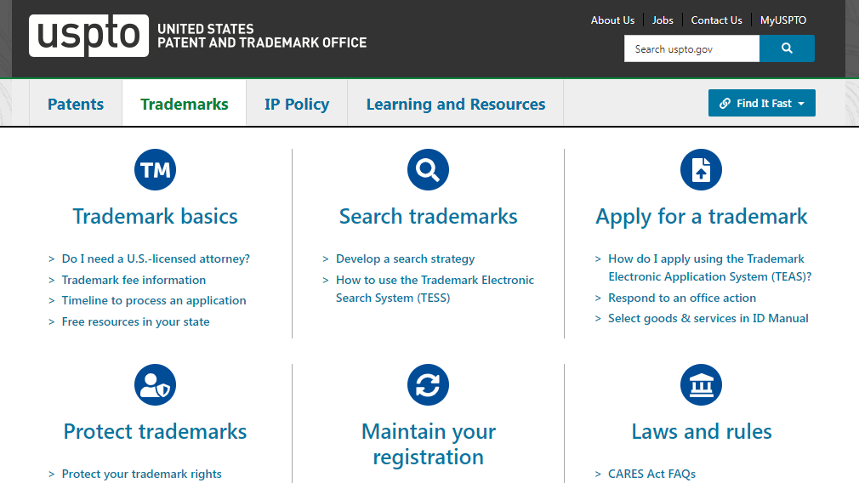
Training – Specialized courses
HOW TO SEARCH THE US TRADE MARK DATABASE
Step 1: Open your browser and go to https://www.uspto.gov/trademark (The United States Patent and Trademark Office's website)

Slide 12
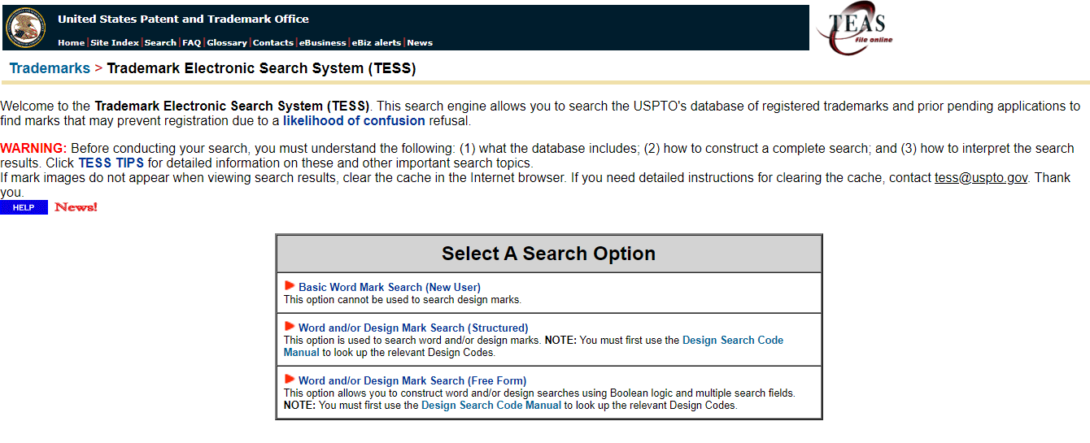
Training – Specialized courses
Step 2: Select “SEARCH TRADEMARKS” by clicking on it. This will open the Trademark Electronic Search System (TESS)

Slide 13
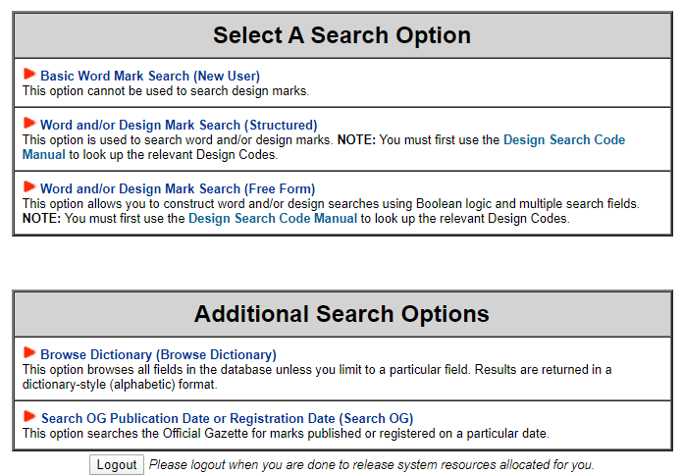
Training – Specialized courses
Step 3: You will be given the option of selecting from several different
"SEARCH LISTS" options. Start with “BASIC WORD MARK SEARCH (NEW USER)" for your first search

Slide 14
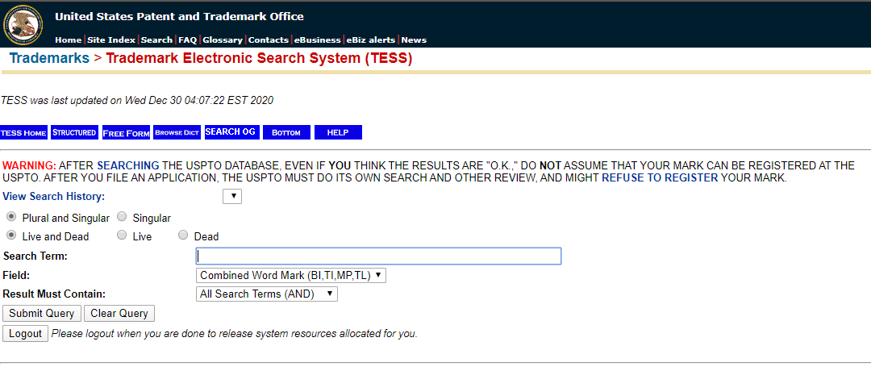
Training – Specialized courses
Step 4: This will open the SEARCH PAGE. Type in the name or title or slogan
you wish to search for. After you set your other search criterion, click on the
button "Submit Query"

Slide 15
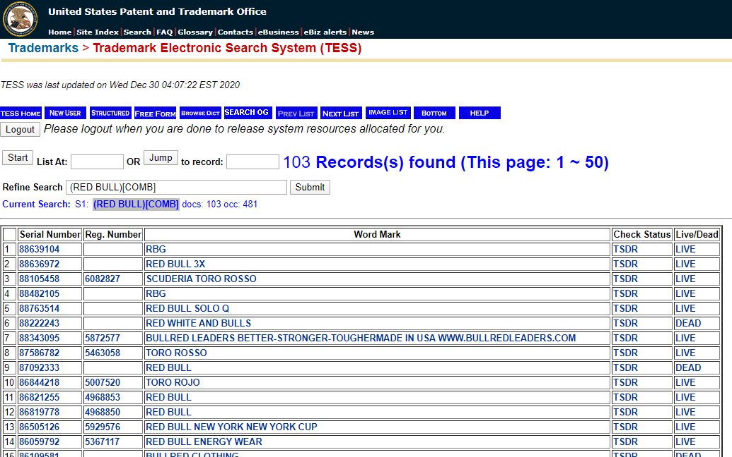
Training – Specialized courses
Step 5: The next page will give you a list of trademarks, if any, that matches
your search term(s)

Slide 16
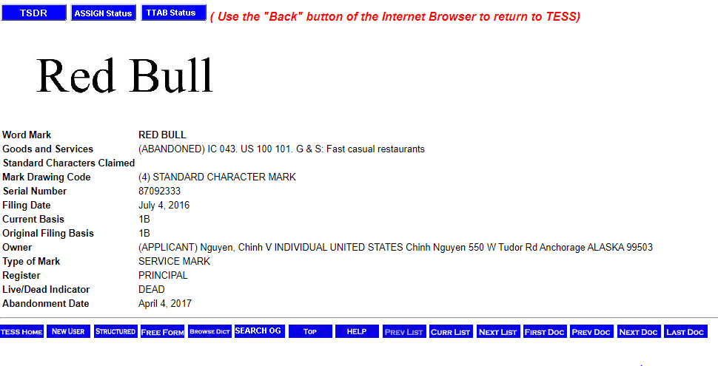
Training – Specialized courses
Step 6: The basic search form of the Trademark Electronic Search System, or
TESS, generates results according to word marks, serial or registration numbers, owners and other commonly searched characteristics of trademarks.

Slide 17
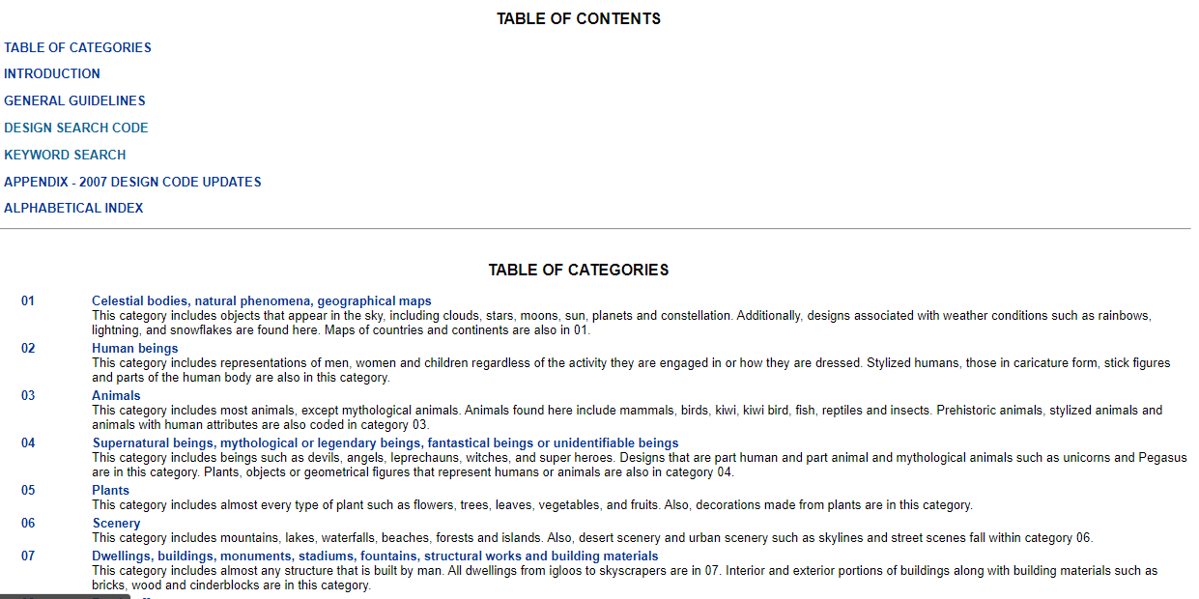
Training – Specialized courses
Step 7: Before attempting to register or use a trademark (logo), all possibly significant elements of the mark should be searched by design code and compared for possible infringement. Each feature of a trademark is assigned a code that can be searched with the TESS. This method of searching is very time-consuming, as it involves viewing numerous pages of graphic representations contained in registered trademarks.

Slide 18
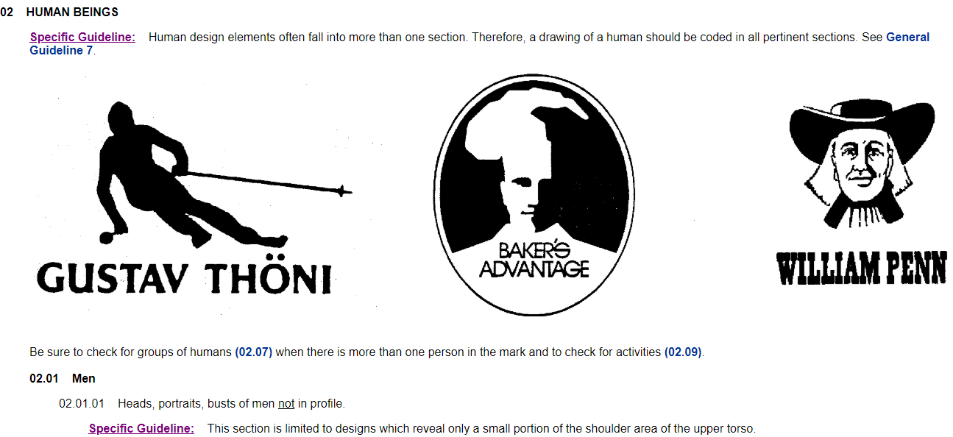
Training – Specialized courses

Slide 19
Training – Specialized courses
Step 8: Analyzing your search results
Go ahead and use your selection if, you do not find any conflicting marks. Begin taking steps to protect your trademark as well.
Decide whether customer confusion is likely to occur if you use your proposed trademark. If customer confusion is likely to occur because of your proposed trademark, pick an alternate from your list and start over.
Compare the class assigned by the PTO to it and the types of goods and services it represents
Selection of the trade mark is the same or very similar to a famous Trademark
If you're sure customer confusion is not likely, and your proposed trademark does not strongly resemble a famous trademark, you may decide to go ahead and use the trademark

Slide 20
Training – Specialized courses
Using wildcards to enhance searches
Wildcards are characters that the search engine recognizes. They add flexibility to your searches:
Multiple character wildcard
“*” Use an asterisk to replace a sequence of characters (e.g., to search for pharmacy and pharmaceutical, use "pharm*").
Single character wildcard
“?” Use a question mark to replace a single character (e.g., "organi?ation" will match different spellings: "organization" or "organisation").
Wildcards in front of characters string
Wildcards can also be used in front of the search term (e.g., "*national” will match different terms such as "national" and "international").

Slide 21
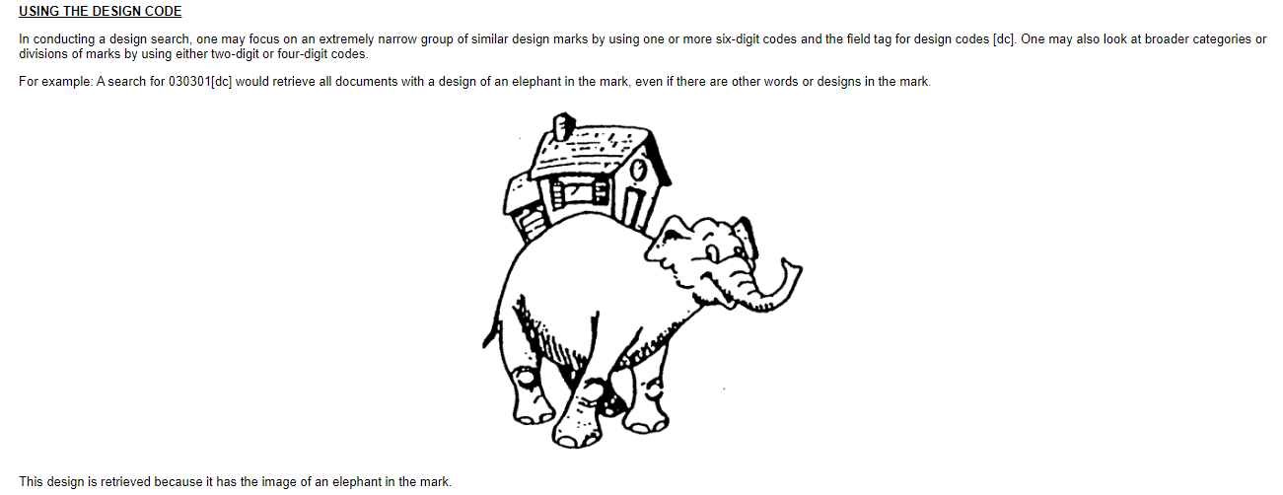
Training – Specialized courses
DESIGN SEARCH CODES
A design search code is a six-digit number that helps the public and examining attorneys search the USPTO database for marks with similar designs. Understanding design search codes will help you conduct a more effective search before you file your application.
Design codes can be searched manually from the following link:-
http://tess2.uspto.gov/tmdb/dscm/index.htm

Slide 22
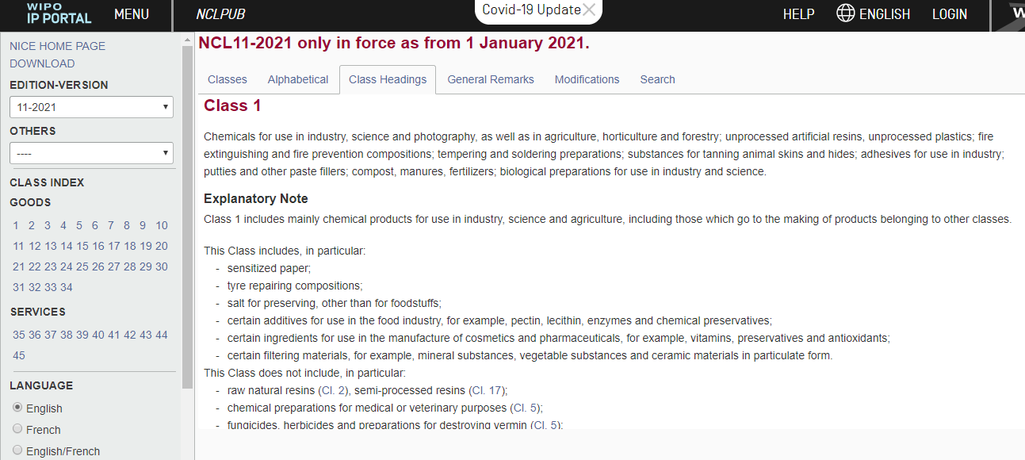
Training – Specialized courses
INTERNATIONAL CLASSES OR NICE CLASSES
In most jurisdictions, the products for which trademarks are registered are categorized using the 45 product classes of the International Classification of Goods and Services under the Nice Agreement. Classes 1 to 34 are used for goods and classes 35 to 45 for services.
International classes or NICE classes can be manually accessed from the following link:-
https://www.wipo.int/classifications/nice/nclpub/en/fr/?class_number=1&explanatory_notes=show&lang=en&menulang=en&notion=class_headings&version=20210101

Slide 23
WIPO – Global Brand Database
WIPO's Global Brand Database enables you to search for trademarks registered under the Madrid System.
TYPES
There are two types of trademark searches, including one for words and one for designs.
Words - You can conduct your trademark search using search words via the
Trademark Electronic Search System (TESS)
Designs - You will still use TESS. However, the USPTO Design Search Code
Manual has to be referred to identify design codes to use with TESS.
If your trademark includes both words and designs, you will need to conduct both types of
searches.

Slide 24
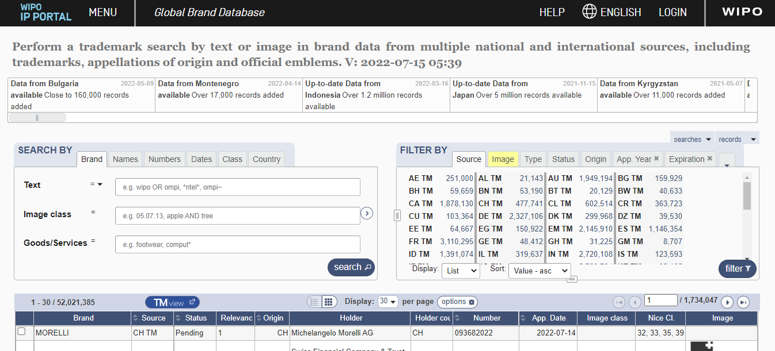
HOW TO SEARCH THE USING WIPO's Global Brand Database
Step 1: Open your browser and go to https://branddb.wipo.int/branddb/en/ (WIPO’s Global Brand Database Office's website)

Slide 25
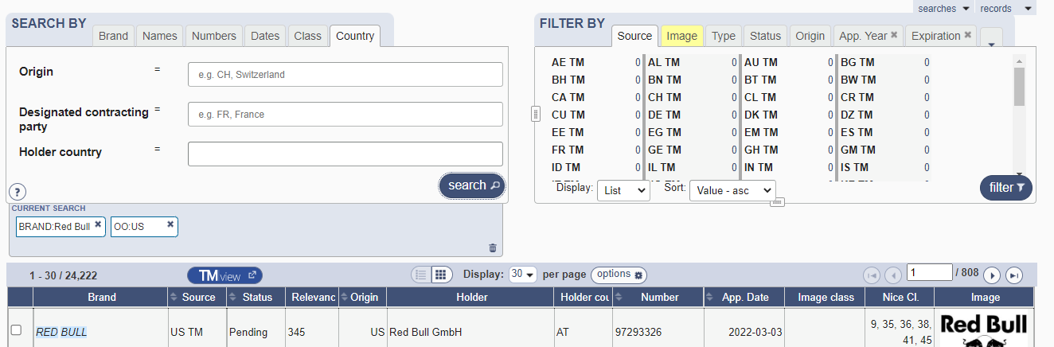
Step 2: Type in the name or title or slogan you wish to search for. After you set your other search criterion, click on the
button “search"

Slide 26
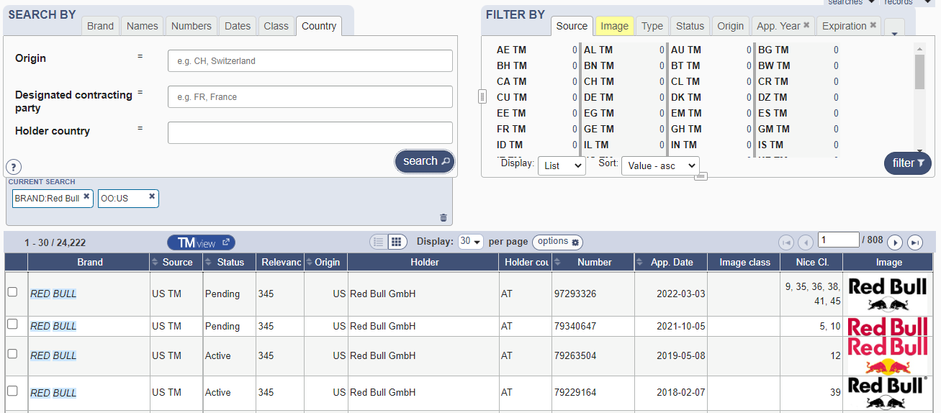
Step 3: The search will give you a list of trademarks, if any, that matches
your search term(s)

Slide 27
TMview – TM across the European Union and beyond
Trade marks protected in the entire European Union, European Union trade marks and designating country within the European Union, can also be searched can also be searched via TMview.
The trade marks protected under the International Registration system (the Madrid system).

Slide 28
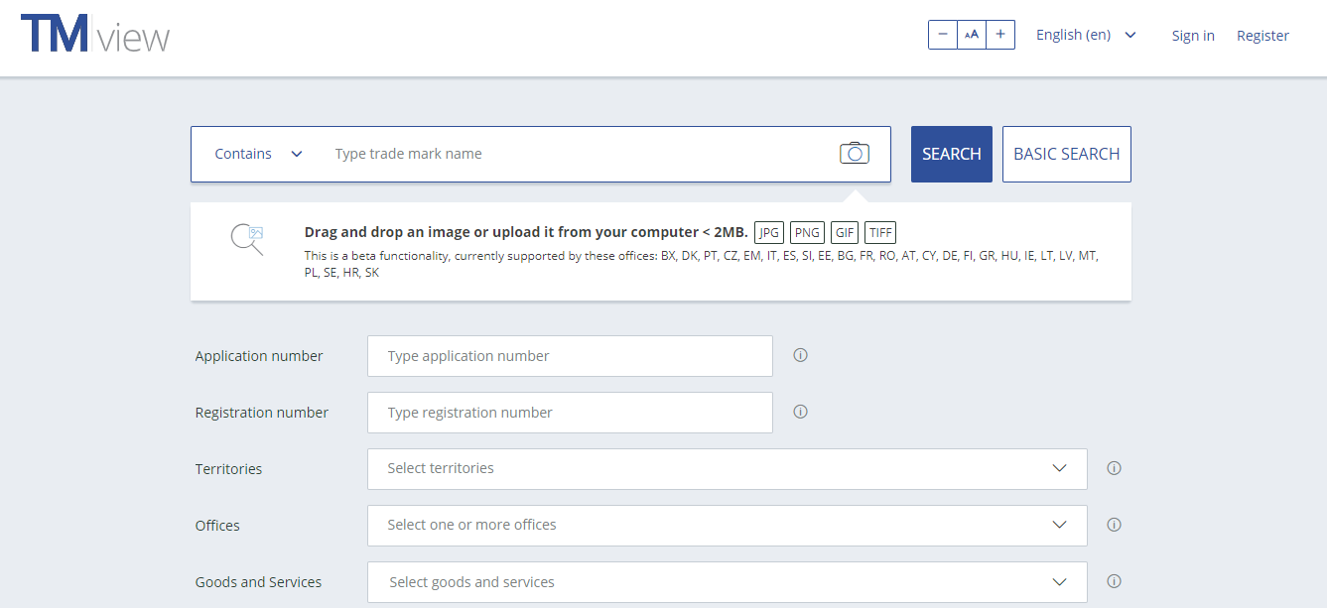
Step 1: Open your browser and go to https://www.tmdn.org/tmview/#/tmview (TMview Office's website)

Slide 29
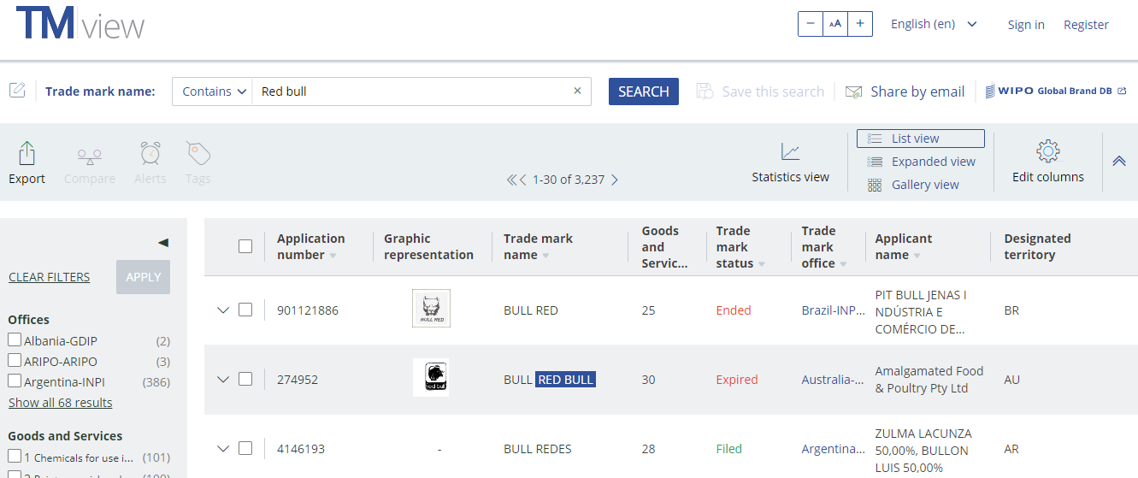
Step 2: Type in the name or title or slogan you wish to search for. After you set your other search criterion, click on the
button “SEARCH"
Step 3: The search will give you a list of trademarks, if any, that matches
your search term(s)

Slide 30
Training – Specialized courses
CONCLUSION
It is advisable to conduct a trademark search not only in your own country but also, as far as is possible, in potential export countries, in order to avoid problems
of infringement at a later stage.

